Slide 1
WPF Containers

Slide 2
Agenda
Absolute position: Canvas
Stacking:
StackPanel, DockPanel, WrapPanel
First in first out
Proportion or row / column:
Grid, UniformGrid

Slide 3

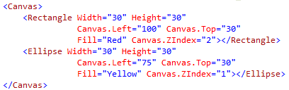

Canvas
Index: Canvas.ZIndex. Bigger number on top
Attached properties
Quiz:

Slide 4
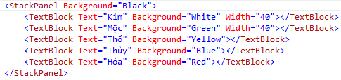
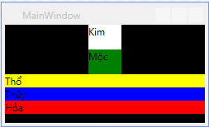
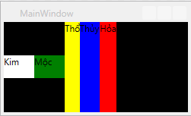
StackPanel
Default: Orientation=“Vertical”
Orientation=“Horizontal”

Slide 5
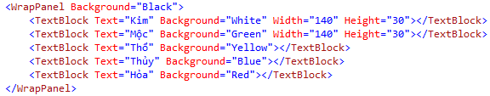
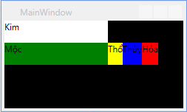
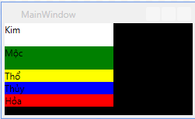
WrapPanel
Orientation=“Vertical”
Mặc định: Orientation=“Horizontal”

Slide 6
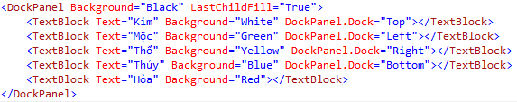
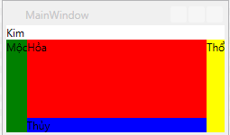
DockPanel
Relative position won’t change
LastChildFill

Slide 7
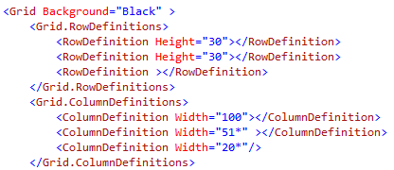
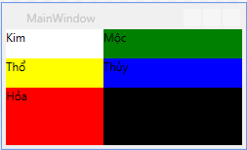
Grid
Table like
Must define columns and rows first

Slide 8

Grid order

Slide 9
Some characteristics of grid
If there is 1 child: auto fill up
If there is n child: last child will overlap previous childs
Specified width / height will lead to horizontal / vertical alignment

Slide 10
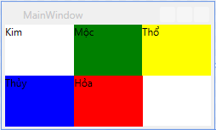
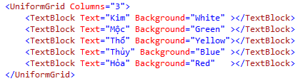
UniformGrid
Same dimensions for all childs
Automatically adjust
FlowDirection: LeftToRight, RightToLeft

Slide 11
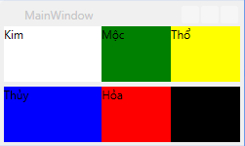
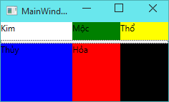
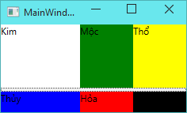
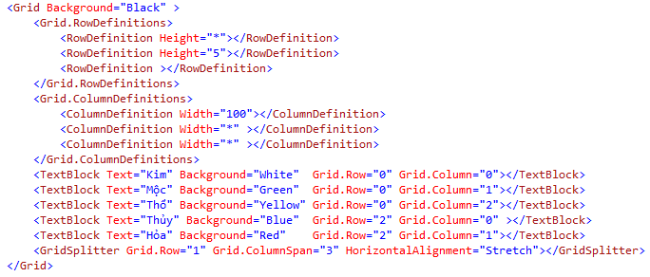
GridSplitter
Allow manually adjusted

Slide 12
Tips – Auto size
HorizontalAlignment="Stretch“
VerticalAlignment="Stretch"

Slide 13
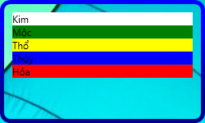
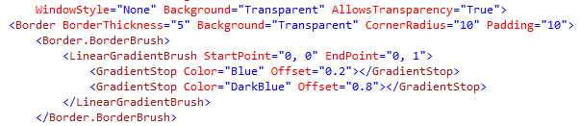
Border
Contains only one child
Some important attributes
BorderBrush
BorderThickness
CornerRadius

Slide 14
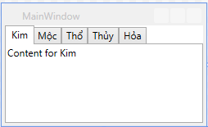
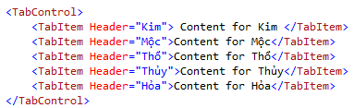
TabControl
Used to switch between pages

Slide 15
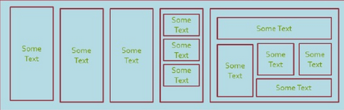
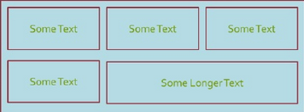
Inclass excersise
Write xaml code to create UI nearly like the image (80%)
Hint: there are a lot of solutions
100
300
1
400
100
200
200
2
400

Slide 16
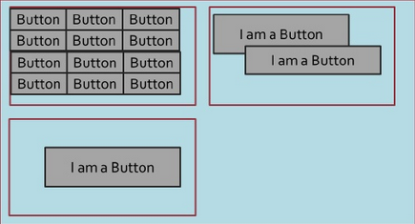
Exercises (cont)
100
300
30
3
300
100

Slide 17
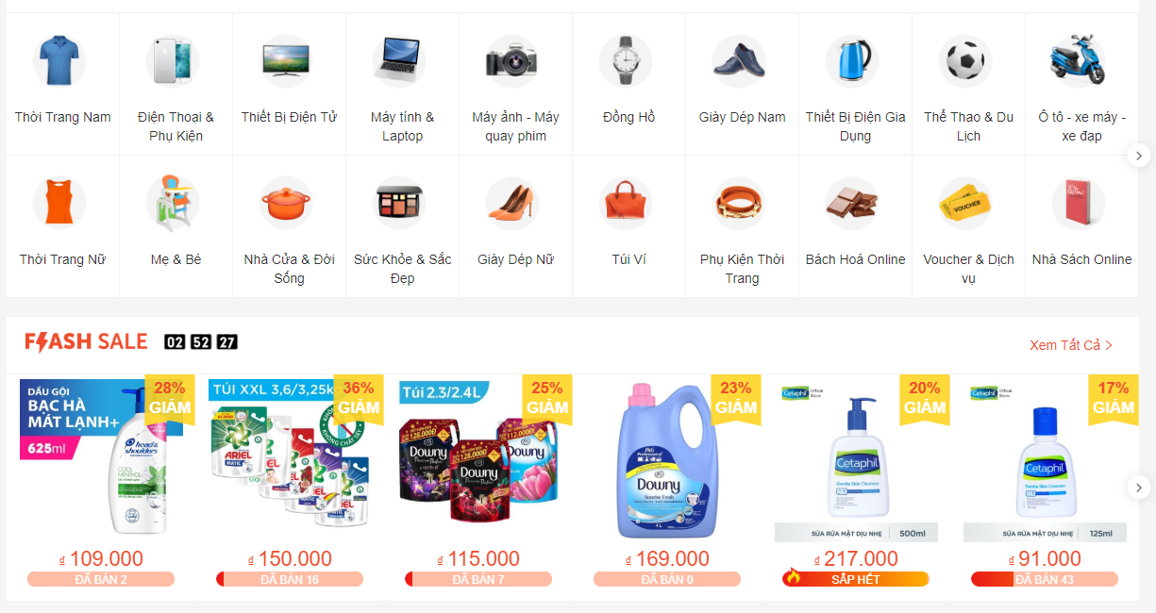
Homework 1 - Shopee

Slide 18

Homework 2 - tiki

Slide 19
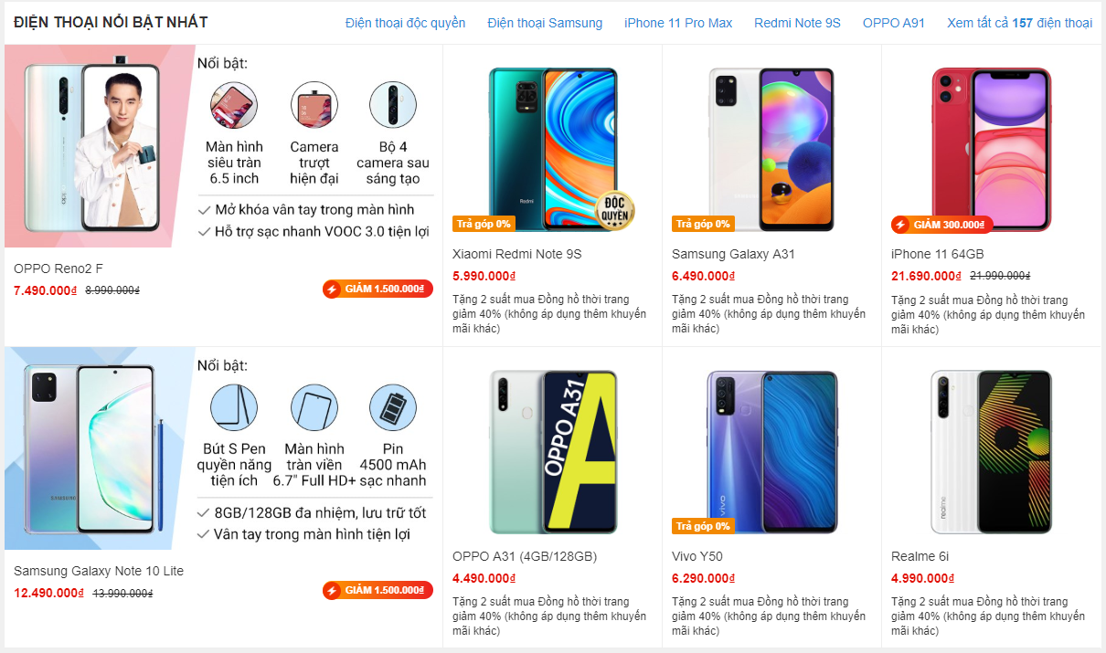
Homework 3 - tgdd

Slide 20
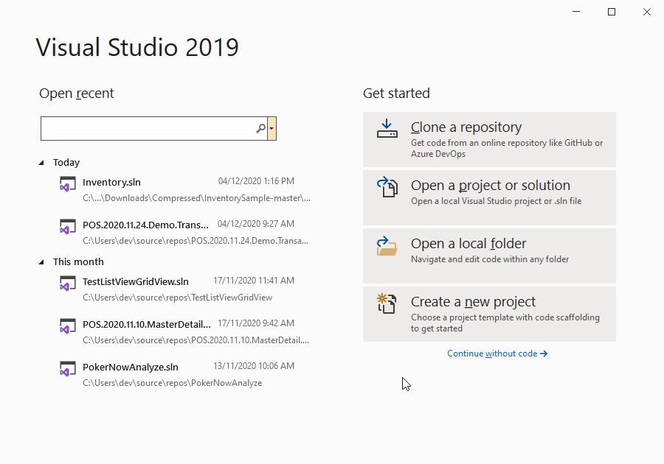
Homework 4

Slide 21
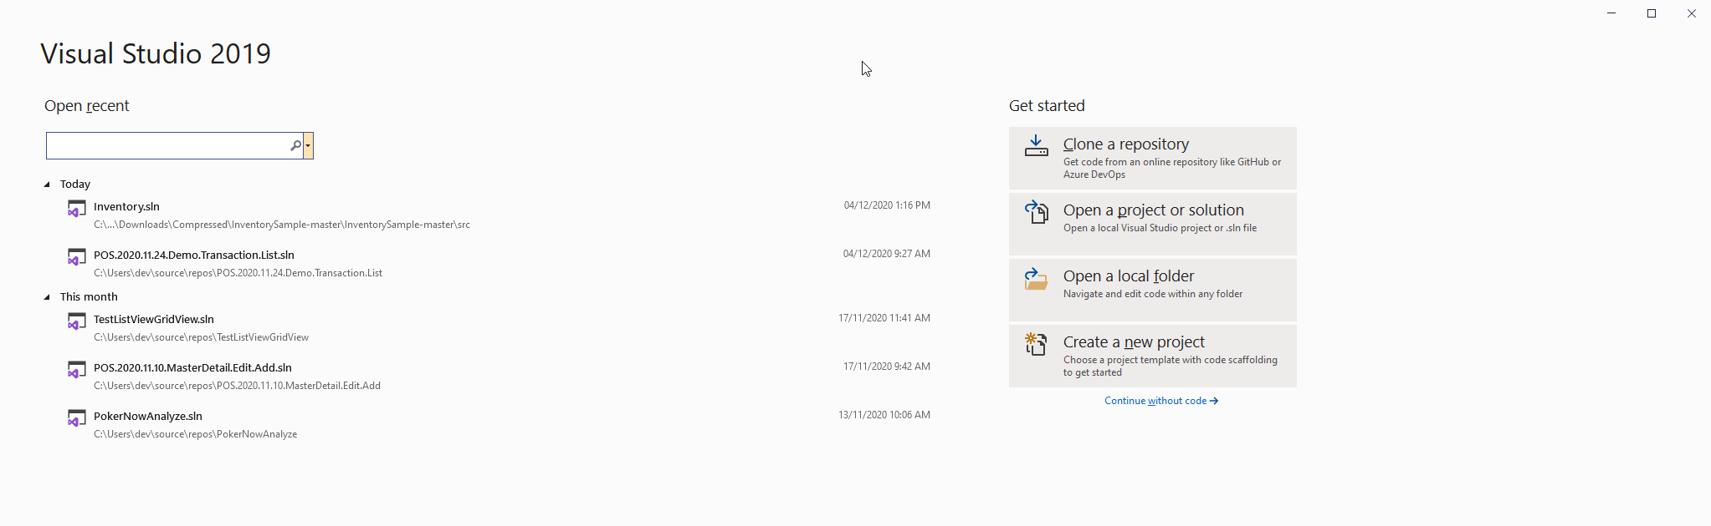
Some thing to notice
We could use two column, the left use MaxWidth, the right is left aligned

